Slide 1

Deep Learning Based Plant Disease Detection for Agricultural Health Monitoring
By:
Berelli Preetham Rao 21R11A05B1
Mamilla Rithika 21R11A05D0
Manda Anjani 21R11A05D1

Slide 2

Under the guidance of
G. Santhoshi Assistant Professor

Slide 3
01
Abstract
CONTENTS
05
System Design
02
06
Objectives
Modules
03
07
Existing System
Implementation
04
08
Proposed System
Conclusion

Slide 4
ABSTRACT
Plant diseases pose a significant threat to farmers globally, often leading to substantial crop loss and decreased agricultural productivity if not identified and managed promptly. Traditional detection methods, reliant on manual inspection, can be slow, labour-intensive, and error-prone, making early and accurate diagnosis a challenge, particularly in large-scale farming operations. To address this, we developed a deep learning-based plant disease detection system utilizing Convolutional Neural Networks (CNNs) that classifies leaf images into 39 distinct disease categories based on visible symptoms like spots, discoloration, and texture changes. Implemented with the PyTorch framework, our model is trained on a large and diverse dataset of plant images, enabling it to accurately diagnose a wide range of plant diseases. The CNN architecture includes multiple convolutional layers for feature extraction, pooling layers for down-sampling, and fully connected layers for classification, enhanced by data augmentation techniques to improve robustness across varying image conditions. By automating the detection process and facilitating real-time identification, our system reduces reliance on manual labour and expert knowledge, empowering farmers to make timely decisions and ultimately reducing crop loss while improving agricultural productivity.

Slide 5
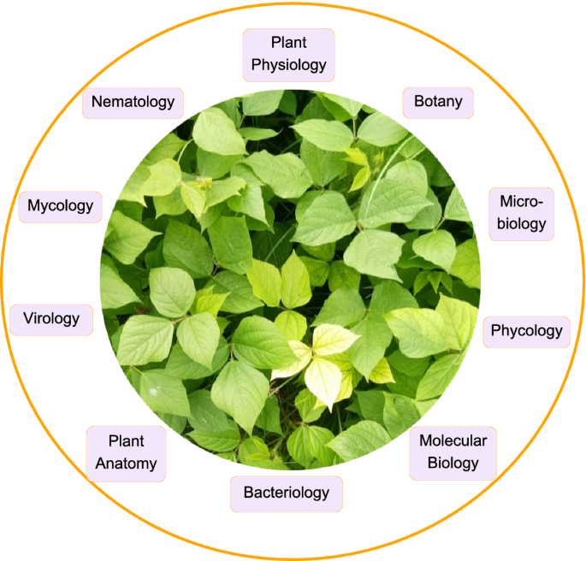
OBJECTIVES
Develop an efficient system for detecting plant diseases through image analysis, providing timely and accurate results for farmers.
Automate the identification of 39 plant disease categories by recognizing visual symptoms like leaf spots and discoloration.
Leverage CNN-based deep learning techniques to improve accuracy by automatically extracting relevant features from images.
Enable real-time diagnosis by allowing farmers to upload leaf images and receive instant feedback on plant health.
Reduce reliance on manual detection methods, minimizing human error and the need for expert intervention.
Create a user-friendly interface for easy image uploads and instant disease diagnosis, even for users with minimal technical expertise.

Slide 6
EXISTING SYSTEM
Plant disease detection often relies on manual inspection by farmers or experts, which can be inaccurate, especially with subtle or similar symptoms.
Farmers may use field guides or apps, but these often lack comprehensive disease coverage and detailed identification methods.
Laboratory diagnostic services are available but are time-consuming and costly, delaying timely intervention.
Traditional methods lack the speed, accuracy, and scalability needed to effectively address modern agricultural challenges.
Delays in diagnosis allow diseases to spread further, increasing the risk of widespread crop damage.
The subjectivity of visual assessment limits consistency, making it difficult to achieve reliable results across different farms and regions.

Slide 7

PROPOSED SYSTEM
The proposed system leverages deep learning and image processing to revolutionize plant disease detection by providing fast, accurate, and scalable diagnoses. Using Convolutional Neural Networks (CNNs), it analyses images of plant leaves to automatically identify diseases based on symptoms like spots and discoloration. Farmers can upload images through a web user interface to receive immediate diagnosis results. The system is trained on a dataset covering 39 plant diseases and offers actionable recommendations for disease management, reducing reliance on manual inspections and expert intervention, ultimately improving crop health and agricultural productivity.

Slide 8
ADVANTAGES
Provides timely and accurate diagnoses, allowing farmers to quickly identify and address potential threats to their crops.
Utilizes deep learning algorithms for high-precision image analysis, significantly reducing the chances of misidentification compared to manual inspections.
Features a user-friendly mobile application, making it accessible for farmers of varying technical expertise to independently diagnose plant diseases.
Capable of classifying up to 39 different plant disease categories, ensuring comprehensive coverage for recognizing a wide range of diseases.
Automates the disease detection process, minimizing human error and leading to more reliable outcomes and better decision-making.

Slide 9
SYSTEM DESIGN
Front End
Flask API
CNN Model
Disease Detection
Image Processing

Slide 10
System Configuration
Software Requirements
Operating System-Windows/Mac/Linux
Jupyter Notebook
Spyder IDE
Visual Studio Code
Hardware Requirements
GPU integrated Laptop / Desktop
RAM : 8 GB

Slide 11
User Interface
MODULES
Flask API
Machine Learning

Slide 12
User Interface Module
Flask API
This module provides the front-end interface of the application, allowing users to interact with the system. It includes pages for uploading plant leaf images, viewing disease detection results, and navigating the application.
A user-friendly interface for users to upload images of plant leaves for analysis.
A section to present the output of the disease detection, including messages such as the type of disease detected, whether the leaf is healthy, or if no leaf was found.
Interacts with the Flask API to submit uploaded images and retrieve results.
Machine Learning

Slide 13
User Interface
Flask API Module
The core server-side component that manages the application logic, processes requests from the UI, and communicates with the machine learning model.
Manages incoming HTTP requests from the UI, routing them to the appropriate handlers for processing.
Contains the logic for processing image uploads, and managing responses based on predictions from the model.
Facilitates communication between the Flask API and the backend CNN model, sending uploaded images for analysis and receiving predictions.
Machine Learning

Slide 14
User Interface
Flask API
Machine Learning Module
This module handles the training, deployment, and inference of the Convolutional Neural Network (CNN) model used for detecting diseases in plant leaves.
Involves data preprocessing steps (e.g., image resizing, normalization), design and training of the CNN model, and optimization of model parameters.
Responsible for classifying uploaded leaf images by analysing the input image and predicting whether it is diseased, healthy, or has no leaf present.
Implements methods for evaluating model accuracy, tracking performance metrics, and monitoring the model's effectiveness over time.

Slide 15
IMPLEMENTATION

Slide 16
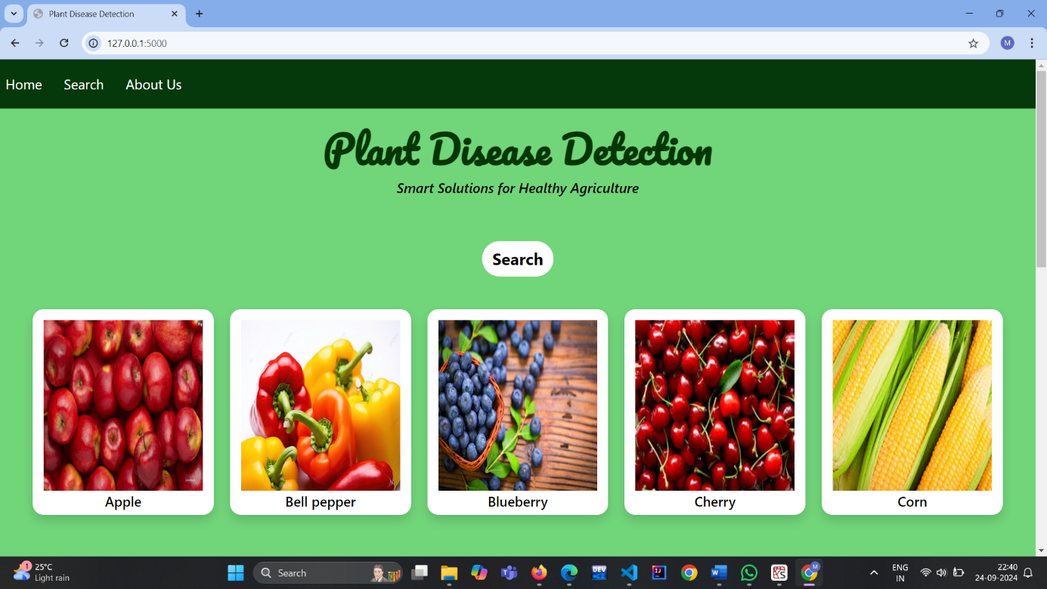

Slide 17
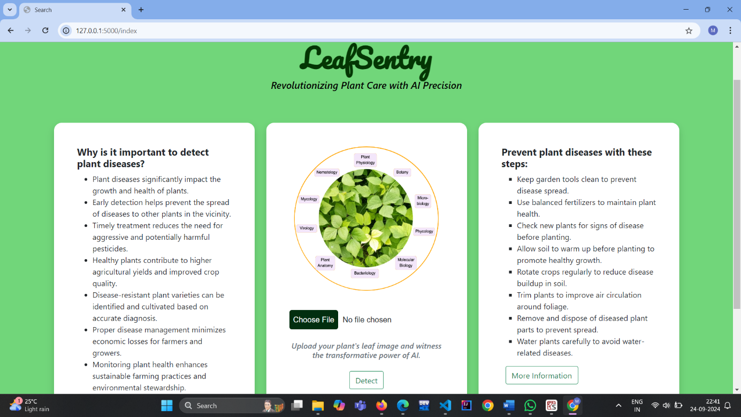

Slide 18
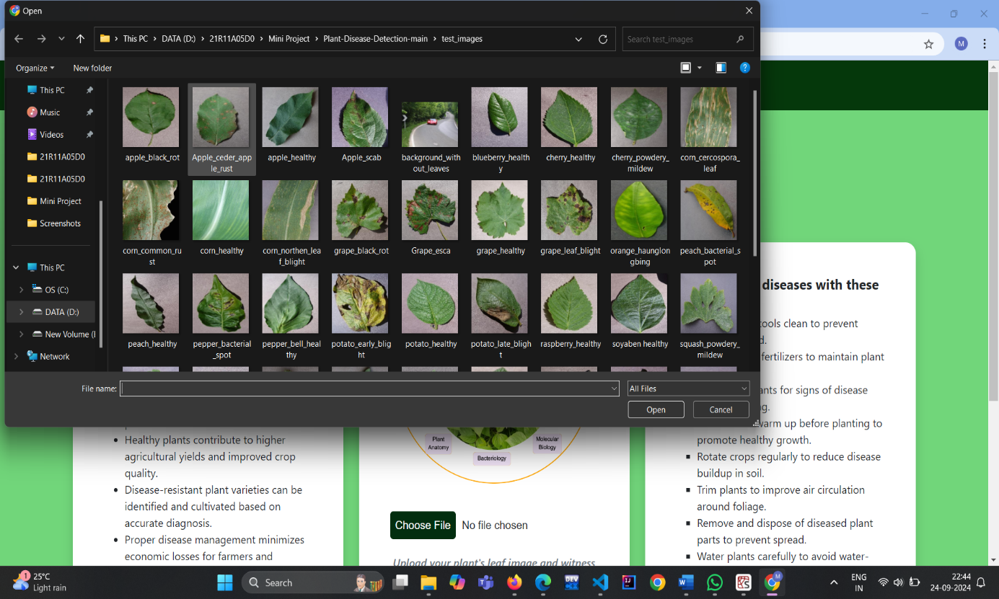

Slide 19
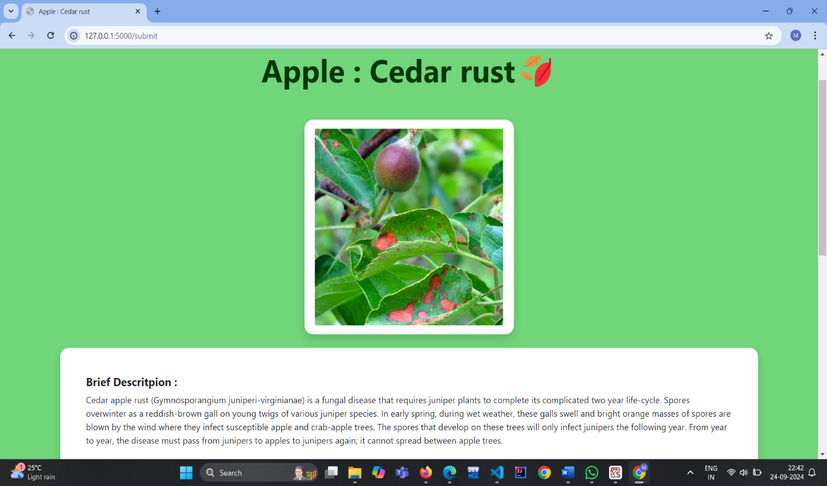

Slide 20
CONCLUSION
In conclusion, the development of the plant disease detection system using a Convolutional Neural Network (CNN) has achieved remarkable success, with train accuracy of 96.7%, test accuracy of 98.9%, and validation accuracy of 98.7%, highlighting its strong learning and generalization capabilities. By incorporating both non-augmented and augmented images, the model has become highly robust, effectively adapting to diverse real-world conditions for precise classification of plant diseases. The system’s user-friendly interface and efficient backend make it accessible to users without technical expertise, offering a practical solution for early disease detection and proactive crop management. As agriculture evolves, this system holds great potential to promote sustainable farming practices, improve crop health, and enhance food security.

Slide 21
Further Enhancements
Expanding the dataset to include a wider variety of plant species and additional disease classes would provide the model with more comprehensive training data, enhancing its accuracy and generalization capabilities.
Implementing a user-friendly mobile application could allow users to easily capture and upload images directly from their smartphones, facilitating quicker and more accessible disease detection in the field.
Incorporating advanced techniques such as transfer learning, where a pre-trained model is fine-tuned on the plant disease dataset, could also yield significant improvements in accuracy while reducing training time.
Integrating a feedback mechanism for users to report prediction errors would provide valuable data for continuous model improvement.

Slide 22


